Slide 1
Aim: To explain the distribution of diseases of affluence and poverty

Slide 2
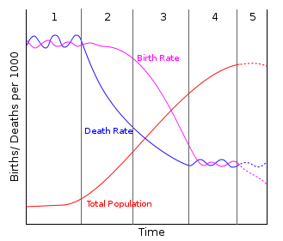
The epidemiological transition model
The replacement of infectious diseases by chronic diseases over time due to expanded public health and sanitation.

Slide 3
Define:
Infectious disease:
Chronic disease:

Slide 4
Can you put these statements into the correct order……….
Chronic and degenerative diseases become major causes of mortality
As countries develop they become more urbanized
Lifestyle changes become detrimental to health
Less active lifestyles plus more meat, more sugar and fat in the diet
Infectious diseases are reduced
Sanitation and food supply improves-increase in standard of living
People begin to adopt habits from HIC’s
As countries develop they become more urbanized
Sanitation and food supply improves-increase in standard of living
Infectious diseases are reduced
People begin to adopt habit from HIC’s
Less active lifestyles plus more meat, more sugar and fat in the diet
Lifestyle changes become detrimental to health
Chronic and degenerative diseases become major causes of mortality

Slide 5
Some vocab
Prevalence
non-communicable disease
incidence
communicable disease
vectors

Slide 6
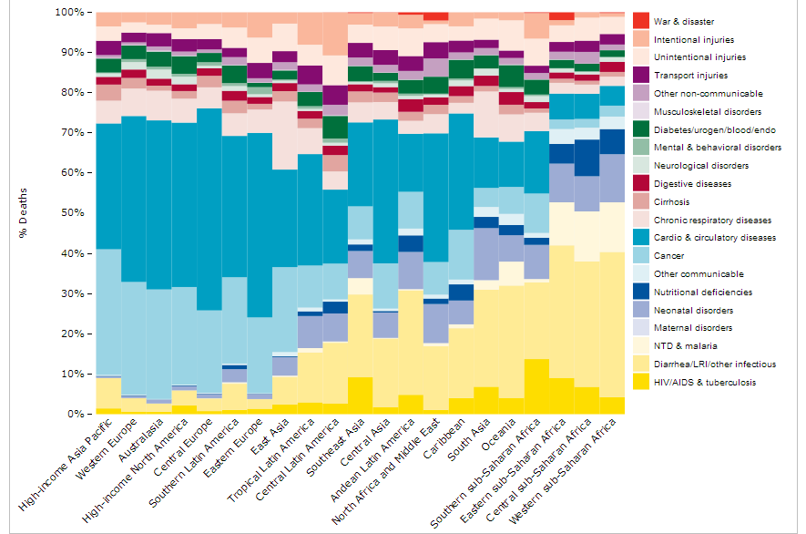

Slide 7
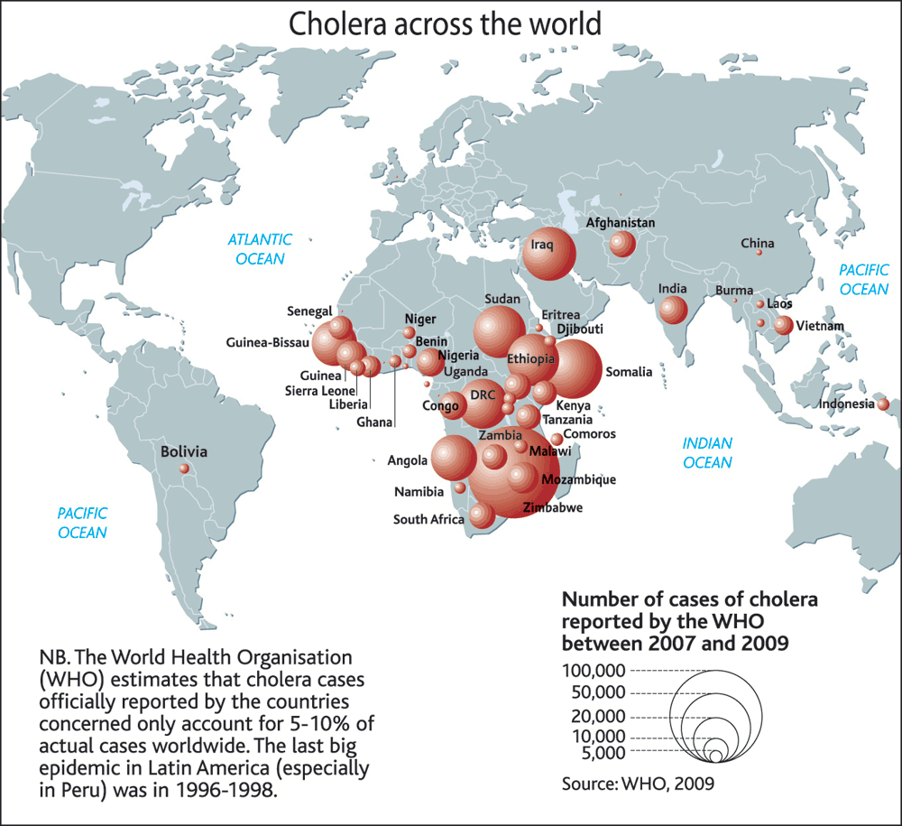
Explain the global distribution of cholera (6)

Slide 8
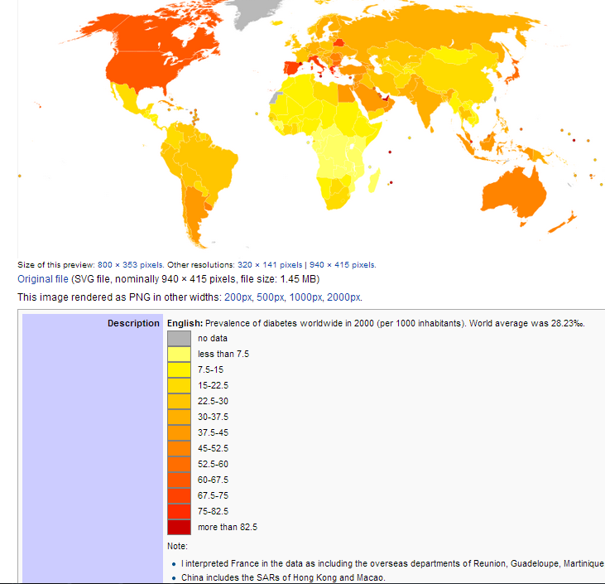
Explain the global distribution of diabetes (6)

