Slide 1
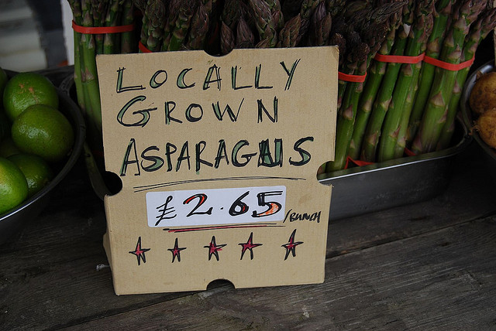
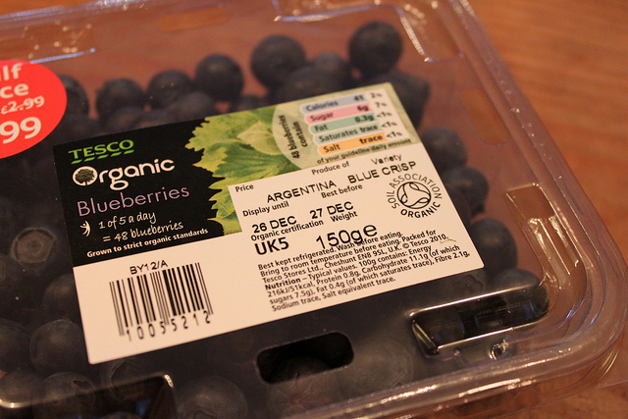
Aim: to examine the concept of food miles as an indicator of environmental impact.

Slide 2
define: food miles
A measure of the distance that food travels from its source to the consumer.
This can be given either in units of actual distance, or of energy consumed during transport.

Slide 3
Food Mile facts:
Food distribution is about 40% of all UK road freight
Food transport is almost totally dependent on oil
Locally sourced carrots have 20 food miles whilst conventionally sourced were 1,838 miles.
If all foods were sourced from within 20km of where they were consumed, the UK would save £2.1bn in environmental and congestion costs.
Average distance food is transported in HIC’s has increased by 25% since 1980

Slide 4
Environmental Impact:
The food we eat makes up approximately 28% of our ecological footprint (unless you are Zoe)
Seasonal eating is gone – eating according to season: cold storage uses additional energy and resources
Packaging: individually wrapped items create a lot of waste AND require a lot of energy to pack
Water use: one broccoli head=41 litres of water
Methane – increasing due to flatulence!!
230kg of beef = 5 kilos of greenhouse gases!

Slide 5
Social Impact:
Arguments have become much more compex with time…
One million African workers now depend on fruit and vegetables specifically grown for the UK market and without with they would struggle to survive.

Slide 6
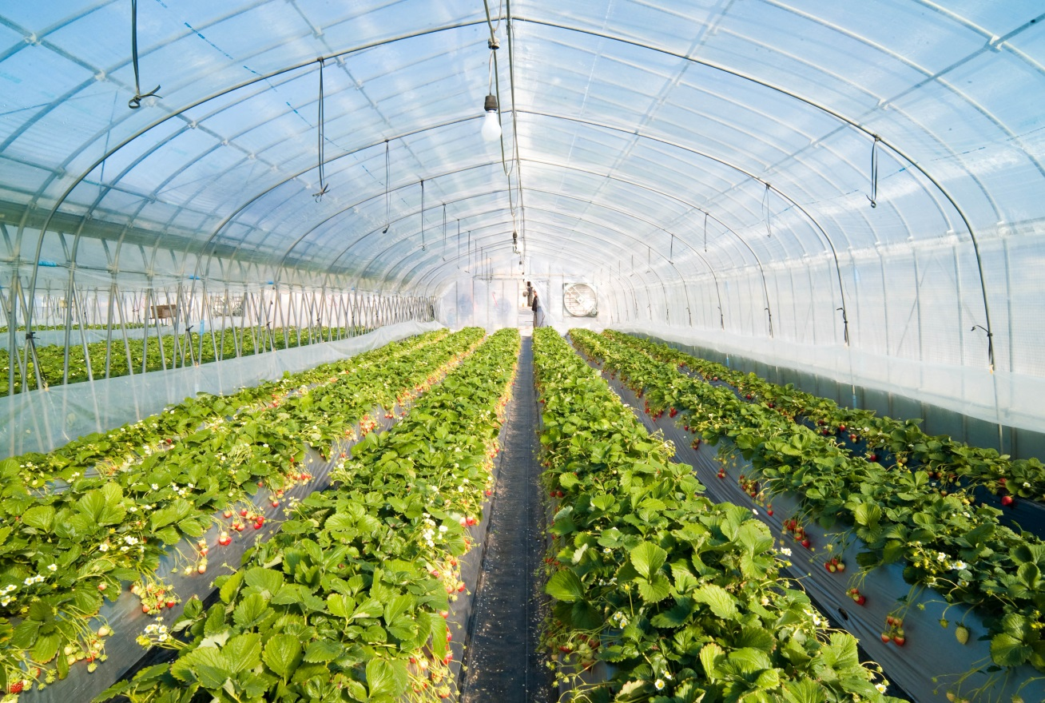
BUT Is food miles a good measure?
Can you think of an example where locally produced food would consume more energy than imported?

Slide 7
Locally produced food can use a huge amount of energy
eg. If the climate is not suitable in a local region, a greenhouse may be used which increases energy used to a point where it is more than importing the food.
Download the food miles or fair miles worksheet (11b) and answer the questions in your notes……

