Slide 1
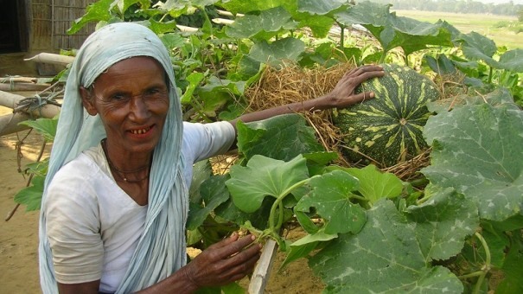
Appropriate Aid is…
Aid that is suited to local conditions and takes into account the wishes and needs of the local population

Slide 2
Sustainable development is……
Development that uses a resource but does not destroy the resources for future generations.
It aims to protect the environment and involve local people while taking into account their concerns and well-being

Slide 3
What were your conclusions about ‘appropriate aid’ in Ashanti?
Most important
Least important

Slide 4
Water and Sanitation: Basic Human Needs

Slide 5
Water Gender Imbalance

Slide 6
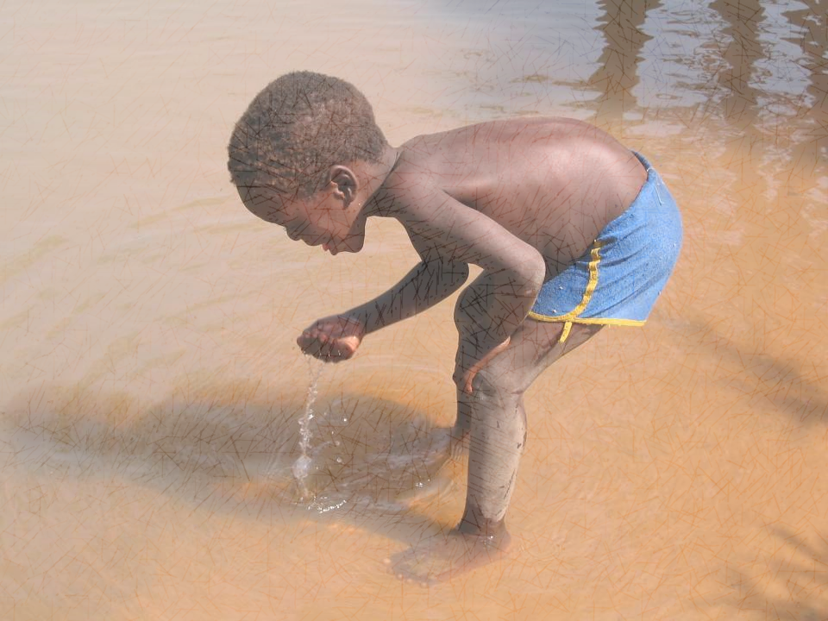
Water-related illnesses such as cholera and typhoid affect more than 1.5 billion people and kill nearly 1 million people every year
1/3 medical facilities in LICs lack access to a safe water source
Diarrhea is the 3rd leading cause of child death leading to malnutrition and starvation

