Slide 2
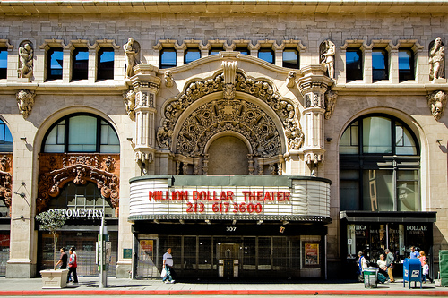
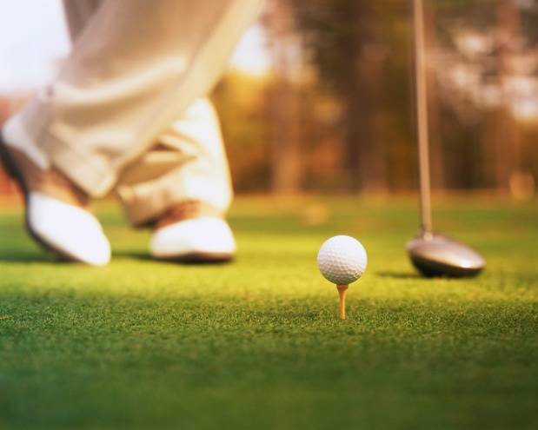
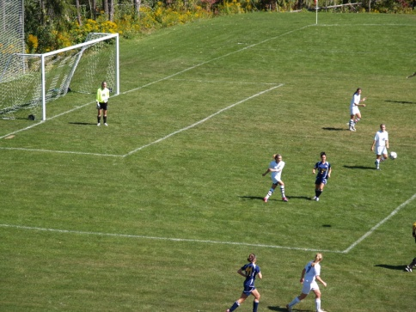
DESCRIBE AND EXPLAIN THE distribution of recreational and sports facilities in urban areas

Slide 3
As settlement size increases there is a greater variety of leisure and recreation facilities available.
This is because the sphere of influence of a city is bigger than a village so there are more people to use the leisure service.
Threshold population is the minimum people needed to run a particular activity. With more people, a greater variety of activities can be offered.

Slide 4
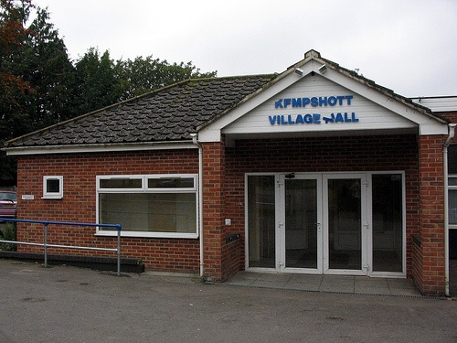
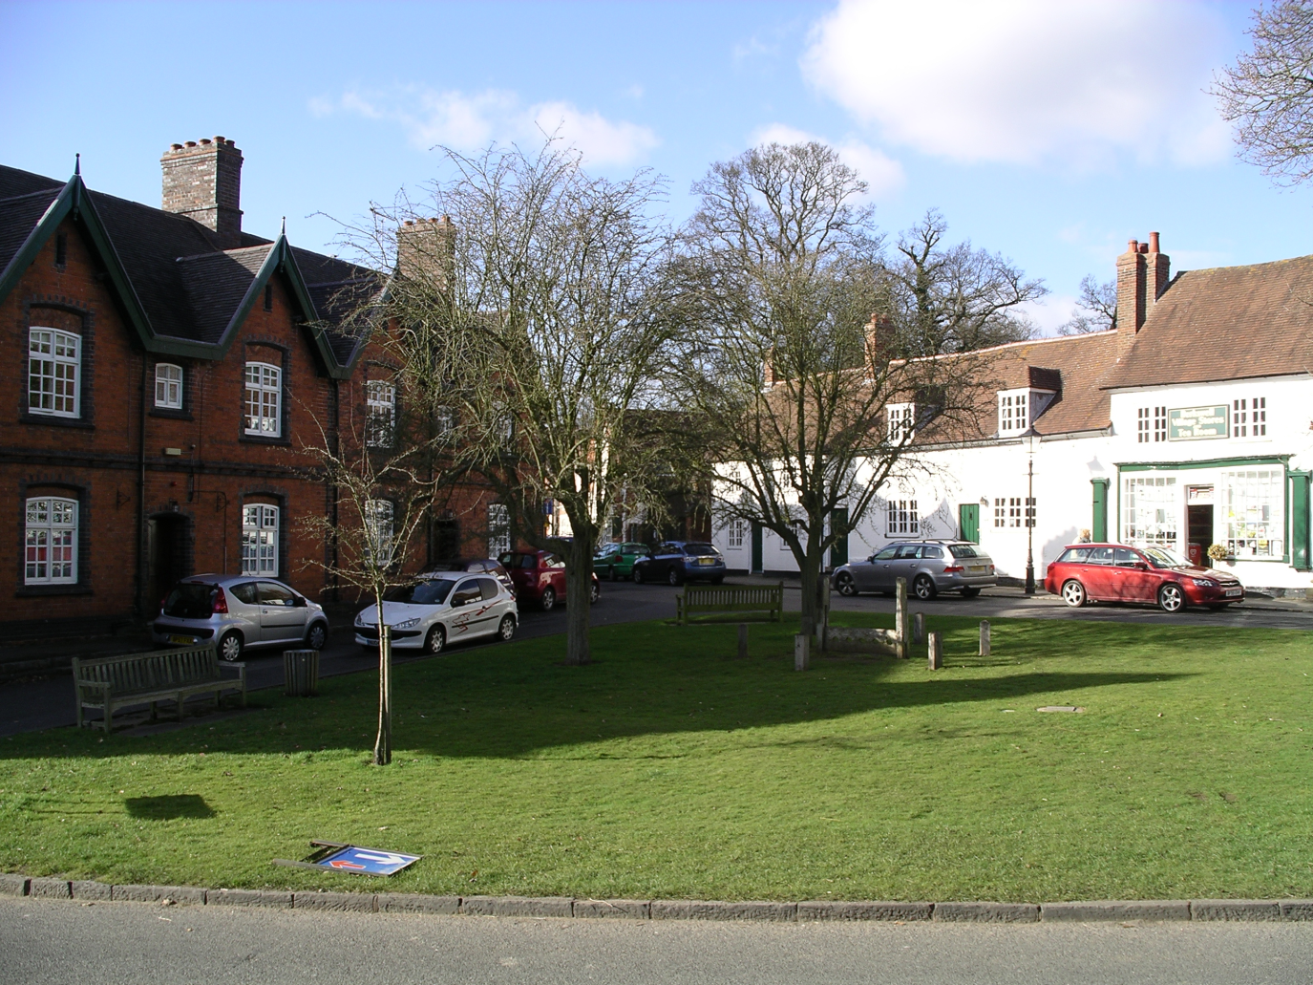
Village

Slide 5
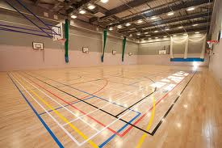
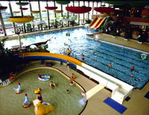
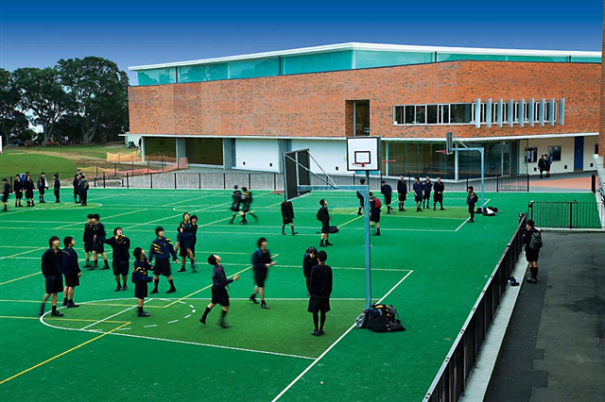
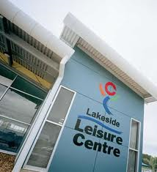
Town

Slide 6
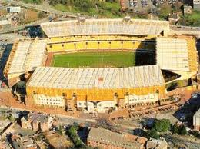
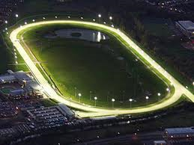
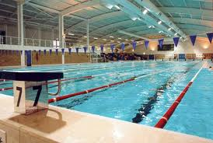
City

Slide 7
Community Leisure example:
Community size | Facilities found | Activities offered
Village 500-1500 people | Village hall or community hall Community open space in centre of village | Keep fit classes Football, Cricket yoga
Town 2500-6000 people | As above plus Tennis courts Sports halls and swimming pool – may be attached to a large school | As above plus Tennis, gymnastics, hockey
City 6000 + people | National sports centre eg. Dunstall racecourse in Wolverhampton Larger facilities such as Olympic size pool | As above plus home grounds of football and hockey arenas Championship level competition in sports

Slide 8
Intra Urban spatial patterns (ie patterns WITHIN urban areas)
CBD
Concentration of leisure facilities in the central area of the city where access is good.
These facilities serve residents of the town and the surrounding rural areas – large sphere of influence for high quality
Facilities such as theatres, library, historic buildings, sports clothing and equipment shops, museums. These facilities don’t take up a lot of space in the CBD where cost of land is high.

Slide 9
Edge of CBD area
Serves the people who live in the town and surrounding area – large sphere of influence
Development of brownfield sites for leisure facilities (Olympic Park in London or Canadian Tire Centre in Ottawa)
Influenced by government policy where planners have to use brownfield sites in cities rather than new greenbelt land
Local facilities requiring space such as swimming pools, parks, bingo halls, stadiums

Slide 10
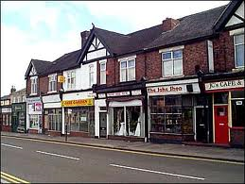
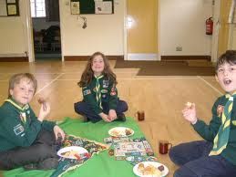
Suburbs
Facilities only serve the local neighbourhood population (small sphere of influence)
School community leisure centres
Local libraries
Shopping parades
Local clubs such as scouts

Slide 11
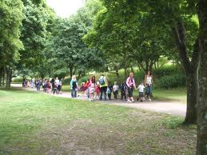
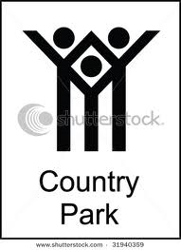
Urban – rural fringe
Serves the city and all surrounding population, especially for weekend recreation – Large sphere of influence
Large OPEN SPACES such as country park or nature reserve with nature trails
Garden centres and farm shops
Golf courses which require a lot of land

Slide 12
Exception…
there are factors which might mean that a settlement has more leisure/tourist facilities than you would expect. These might include:
Level of development
Location (near the coast or a National Park)
Accessibility (airport, roads, railway)
History (historical buildings or events)
Advertising and recognition
Weather
Events e.g. Olympics, Rugby World Cup

Slide 13
Beast of a question from old paper!!
Using only an annotated sketch map, describe and explain the location of leisure facilities in and around a named urban area (8)
Map should have:
North Line
Scale
Key
Labels/annotations

Slide 14
- Sign in to ‘google maps’ street view and search Miami – draw and annotate on your map the following, describing whether/how Miami follows the general pattern of intra-urban leisure distribution
Miami community center - shade location densities – annotate one
Miami golf course
Library - shade location densities – annotate two
Miami theatre – location densities only
center for the performing arts
Parks - location densities, annotate one
Sunlife stadium (Football) and Marlins Park (Baseball)
Everglades wildlife management area
‘Rough’ routes of highway 95, 90, 836 and 1

