Slide 2
Aim: To explain the concept of sustainable agriculture in terms of energy efficiency ratios and sustainable yields.

Slide 3
What is a sustainable yield?
Sustainability - meeting the needs of the present without compromising the ability of future generations to meet their own needs.
A sustainable yield involves the production of food in such a way as to maintain the capacity for growing food from the same land in the future.
Production of sufficient food
Farmers standard of living/profits
Soil conservation and soil health
Nutrient recycling e.g. animal waste being used for fertilizer
Biodiversity –a minimal use of chemicals on the land
Animal welfare
Fair wages and treatment for workforce – farm is part of the rural community
Which are social, economic and environmental?

Slide 4
What is energy efficiency ratio?
Measures of the amount of energy put into a system compared with the output.
Inputs : outputs
Put these in order from most to least efficient..
Shifting cultivation
Deep sea fishing
Intensive poultry farming
Rice cultivation on terraces
Cattle grazing
Dairy farming
Coastal fishing
Shifting cultivation 1:20
Rice cultivation on terraces 1:5
Cattle grazing 1:2
Dairy farming 1:1
Coastal fishing 1:1
Intensive poultry farming 2:1
Deep sea fishing 10:1

Slide 5
Sources of energy include:
Indirect
Fertilizers and pesticides
Seeds
Irrigation
Electricity
(eg. Greenhouse)
Transport
Direct
Labour
Machinery
Fuel
Financial Capital
Whilst farming in HIC’s may be highly productive – it is not always energy efficient, requiring many inputs for success

Slide 6
Factors affecting efficiency
Am I more or less efficient?
Greenhouse Open field Subsistence Cash crop
Beef farming Rice farming
Cooler climate Warmer climate
Wetter climate Drier climate

Slide 7
How can farmers increase sustainability?

Slide 8
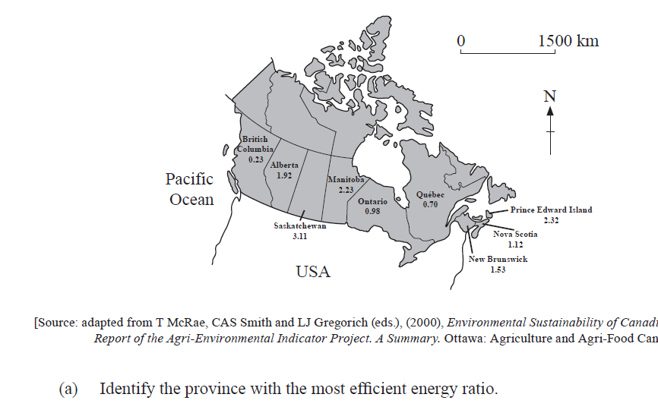
Other ppq

Slide 9
