Slide 1
Aim To know a case study of a national sports league – English Premier League
To examine the relationship between team location and the residence of its supporters.

Slide 2
What is a sports hierarchy?
A sports league is when:
An organisation coordinates a group of individual clubs that play each other
A league system is when:
A number of sports leagues are tied together in a hierarchy
A hierarchy of teams is when:
The best teams get promoted to a higher division and the worst teams are relegated to a lower division.
There are more teams playing at the lower division and fewer teams playing in the higher division

Slide 3
English Premier League

Slide 4
What is the sphere of influence of a league team?
Sphere of influence means:
the average distance people are willing to travel to get to a particular service, in this case a stadium

Slide 5
Do local residents always support their nearest team?
Most supporters will come from the local area
Some supports may be from other parts of the country
A few supporters may be from other parts of the world
This is because:
- people support their local team as games are easy to get to – roads, rail and bus.
- local team often does community work eg. visiting local schools and running soccer camps to encourage kids to become fans.
HOWEVER..
Some people who grew up in the local area may have moved away!
The more successful teams will have more non-local supporters due to:
greater exposure on (sponsorships, media, TV, internet)
Migration
Success - bandwagoners
Better teams have more money to buy more expensive foreign players. Eg. Many people from Ivory Coast supported Chelsea because of Drogba.

Slide 6
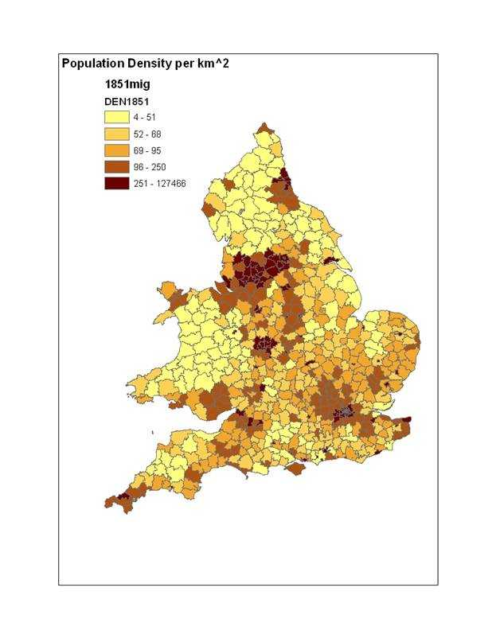
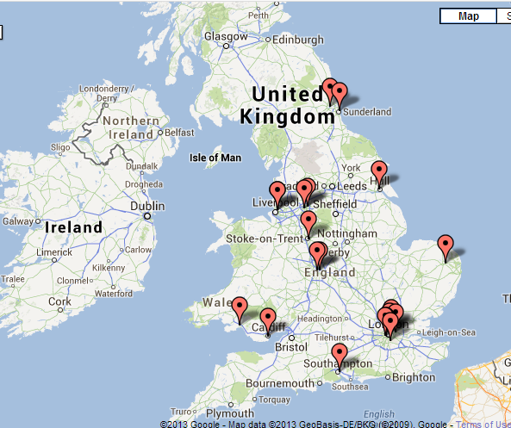
Relationship between location of teams and supporters?
What is the relationship?

Slide 7
Baseball?

Slide 8
The relationship EPL teams and population density is that……
This is because…..
More supporters to attend matches
Club can buy better players
Gives increased success and ensures team remains in premier league
More revenue from ticket sales and revenue

Slide 9
Location of stadiums? …can be either:
Stadium is near the centre of town
Stadium is OUT OF TOWN on a large area of land

Slide 11
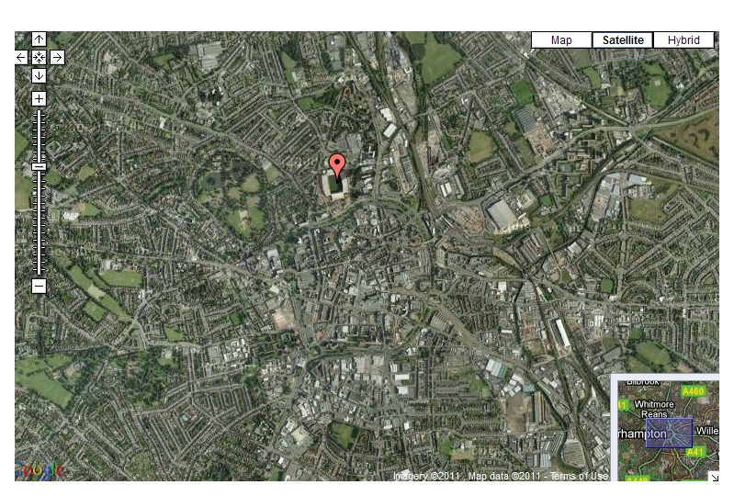

Slide 12
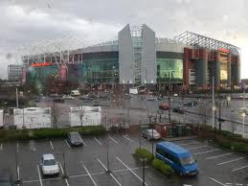
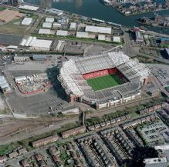
Old Trafford

Slide 13
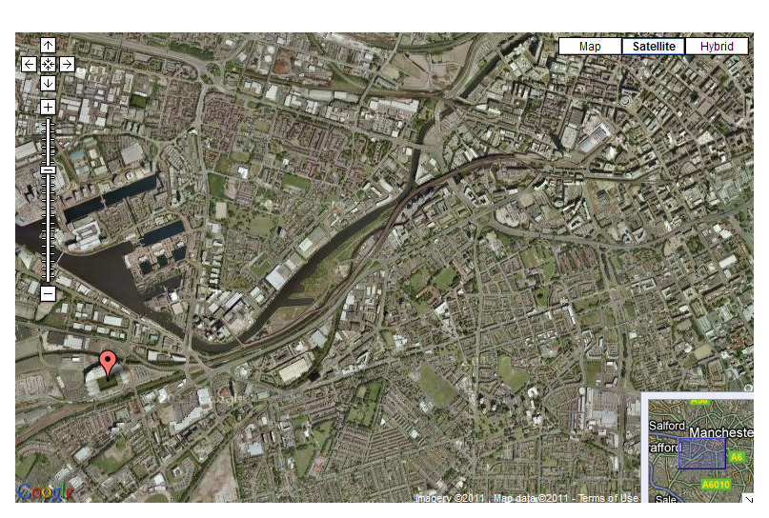

Slide 14
http://www.sportmapworld.com/map/soccer/england/fa-premier-league

Slide 15
Manchester United – out of town stadium
Supporters live further away as stadium not in town centre location
Has its own station for easy access from Manchester (too far to walk) The station is on the Northern Rail line and is only open on matchdays
Next to Manchester Metrolink tram station
Near main road for easy access from motorway
Lots of land for car parking all within ½ mile of stadium
Avoids congestion in city centre

Slide 16
Bahamas national stadium:
http://www.thebahamasinvestor.com/2011/china-presents-bahamas-with-multi-million-dollar-gift/
http://www.bahamas.com/vendor/98859/thomas-robinson-national-stadium
Describe the new stadium and future sports facility development on this site?
What benefits have come from the building of the stadium?
Can you explain the location of this stadium in terms of residence of supporters?

Slide 17
IB question
Explain the relationship between team location and the residence of its supporters ( 10 marks)

