Slide 1
Aim: To understand different migration models

Slide 2
Push / Pull Factors
Push Factors: induce people to move out of their current location.
Ex: poverty, political instability, religious intolerance.
Pull Factors: induce people to move to new location.
Ex. Democratic gov., thriving economies, job opportunities.

Slide 3
Simple Migration Model Notes Activity #1
PUSH
Origin
Migration
PULL
Destination

Slide 4
push and pull factors
Shortage of housing
Inaccessibility
Children leaving home
Planning laws
Divorce
Unemployment
Harsh climate
Natural disasters
Ill health
Ethnic cleansing
Civil unrest
Poverty
Declining neighborhood
Too many people
Safe and secure
Freedom of speech
Good wages
Attractive views
Political asylum
High living standards
Promotion at work
Marriage
Hazard free environment
Low population density
Cheap land
Good welfare and other services
Family ties
Propaganda
Up and coming neighborhood

Slide 5
Lee’s Model of Migration

Slide 6
Characteristics
Every location has a range of attributes.
- negative
+ positive
0 neutral
Different people will have different perceptions of the push / pull factors.
+
-
+
-
-
+
-
+
+
+
+
+
-
-

Slide 7
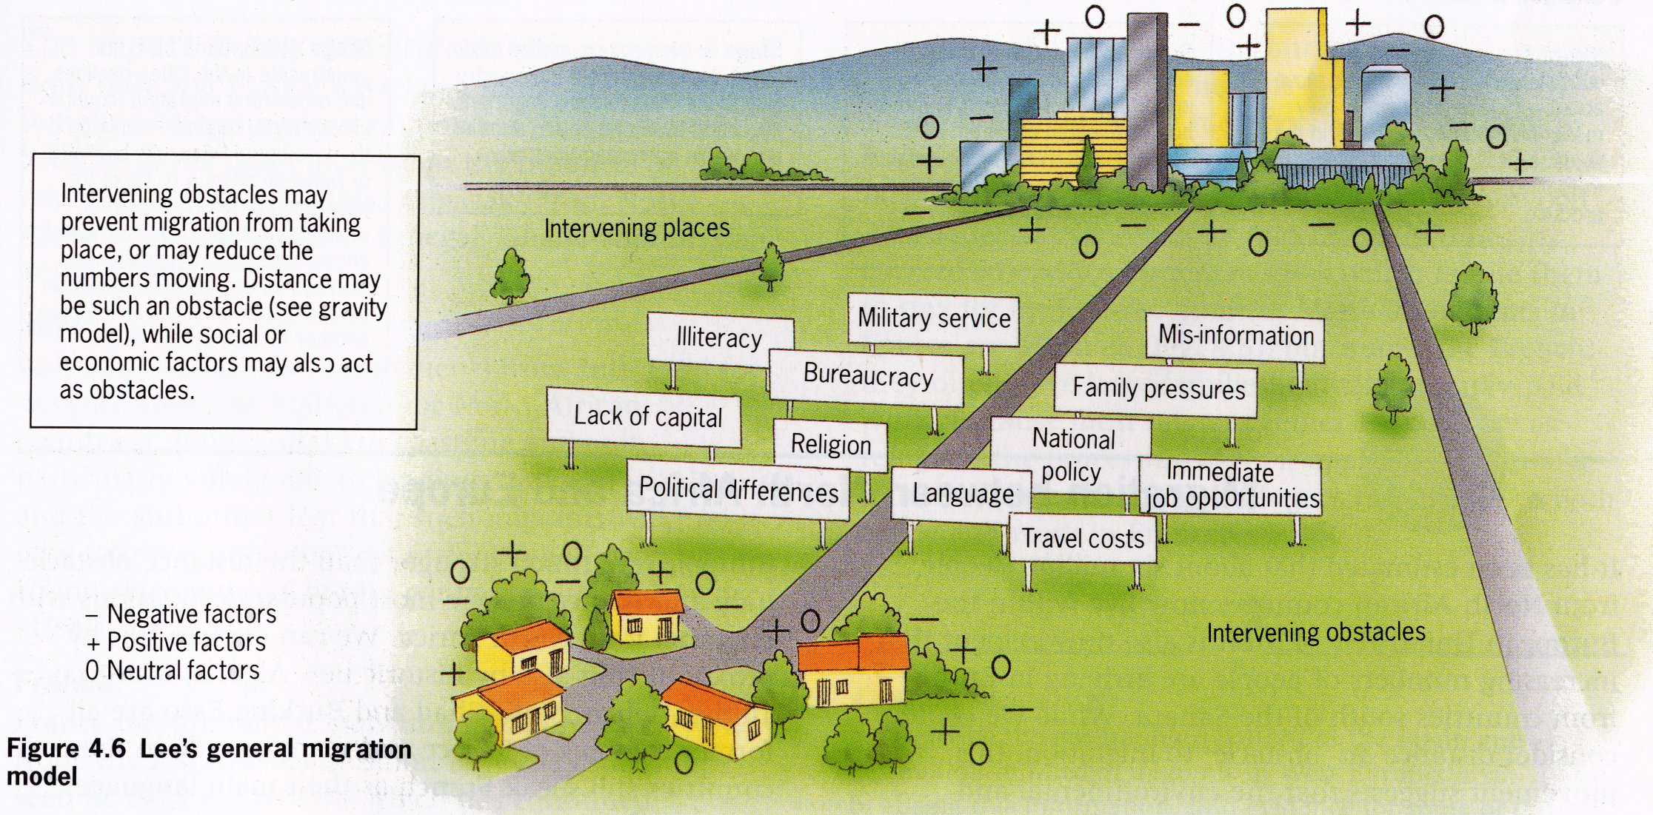
Lee’s General Migration Model
Task 2 - Label some intervening obstacles under your diagram
Source: Population, Resources and Development. Jane Chrispin and Francis Jegede. Collins Educational.1996.

Slide 8
Lee’s Model of Migration
Origin
Intervening Obstacles
Destination
-
-
+
+
+
+
-
-
+
+
+
+
-
-
Could include:
Mountains
Sea
Borders
Rivers
Distance

Slide 9
The Decision
People will decide based on certain criteria
Are the push factors enough to force me to move?
[Forced Migration]
Are the pull factors enough to entice me to move?
[Voluntary Migration]
Do the intervening obstacles make migration worth while?
Is there somewhere closer on the route that I like?
[Intervening Opportunity]

Slide 10
Lee’s Migration Model
Real / Perceived
Intervening Obstacles
Location A
Location B
+
+
-
-
0
0
Does not isolate particular push and pull factors. Each site has a range of attributes. Different people will have different perceptions of the factors.
Intervening Place
?
+
-
0
Explain the model under your diagram
Source: Adapted from Global Challenge. Alistair McNaught and Michael Witherick. Longman. 2001.

Slide 11
Different people have different perceptions of positive and negative attributes……..
Task 3
Can we apply Lee’s model to migration in Germany?
You will be given a personal story of a migrant to Germany. Doing your own research on migration from your home country to the host country of Germany, create a diagram in your notebook of Lee’s Model. For each circle, describe the positives and negatives, the possible positives and negatives of the intervening place, and specific intervening obstacles on the route your migrant must take. BE AS SPECIFIC AS POSSIBLE IN YOUR NEW PERSONA

Slide 13
Ravensteins laws of Migration
What are Ravensteins laws of migration? Ensure you have all 11 rules in your notes.
Highlight which you think are the most important three and justify your choice

