Slide 1
“Being successful in sport doesn’t depend on how good you are – its all about geography…” ?
Factors affecting sports success and participation

Slide 2
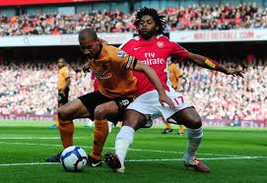
Name the sport….
Soccer

Slide 3
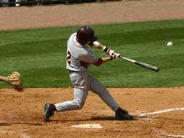
baseball

Slide 4
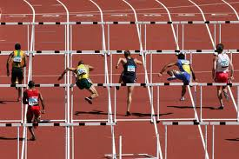
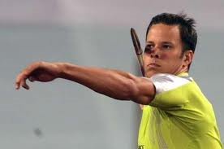
Athletics/ Track & Field
Track and Field

Slide 5
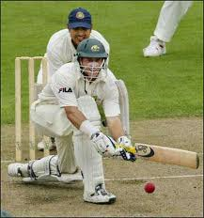
Cricket

Slide 6
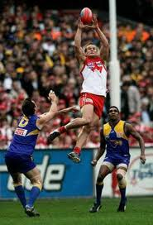
Aussie rules
Australian Rules Football

Slide 7
curling

Slide 8
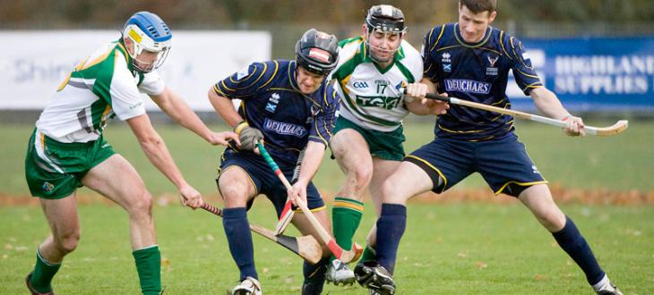
Hurling

Slide 9
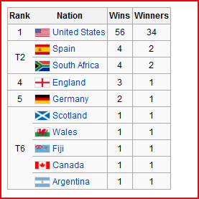
Winners of Golf Masters Tournament
Do the richest nations have the most wins in golf? Can you explain this?
Is golf a global sport in terms of participation? Why or why not?

Slide 10
GHLAD – DESCRIBING PATTERNS ACCURATELY
IN GEO IBDP questions, DESCRIBING a pattern always follows a PATTERN (ahahaha geo humour)… see blow.
G - GENERAL PATTERN - describe generally in a statement. (Ex: most countries with wins in golf are in the northern hemisphere)
H/L – HIGHS and LOWS – Where are the largest and smallest? (The USA has the most wins and many other countries have only one win)
A – ANOMALIES: What doesn’t belong? (Ex: Fiji is the only nation that is not a ‘highly developed’ state)
D – DATA: Use specific data from the graph/infograph in your answer. (Ex: The United States has the most wins at 56 in total)

Slide 11
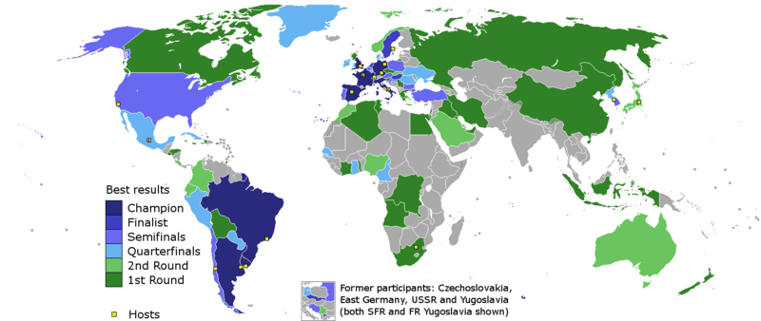
World Cup Wins
Do the richest countries win the world cup? Describe the pattern (GHLAD)
Is Soccer (football) a global sport in terms of participation? Why?
Are there any patterns in nations which have hosted World Cup – can you explain these?

Slide 12
Which factors affect participation AND success in sport?
Wealth (economic)
Physical makeup (biology)
Physical landscape (geography)
Culture (socio-cultural)
Governance (political)
WHICH is the most important in determining success? What about participation?

Slide 13
Go to website under heading 11. “Leisure at an International Scale: Sport” and complete the following:
11b: Use GDP per capita to decide which sport is MOST influenced by wealth... Soccer World Cup Wins Golf Masters Wins Olympic Medals (Summer) or Olympic Medals (Winter)
WRITE A SUMMARY OF YOUR CHOICE AND BRIEFLY EXPLAIN WHY YOU THINK THAT IS
11c: Using the ‘greenfield geography’ website: SUMMARIZE How much economic, socio-cultural, environmental, biological, or political factors play a role in determining success in golf? Write a few sentences for each factor.

