Slide 1
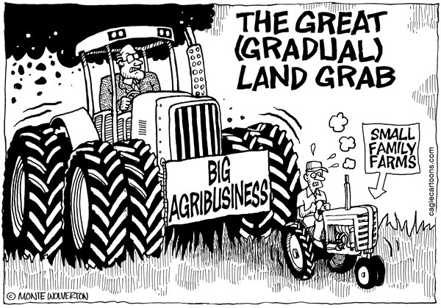
How the availability of food has increased??

Slide 2
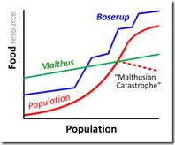
Links to Boserups theory…….

Slide 3
How can we increase the availability of food?

Slide 4
changes in agricultural systems
Small scale to large scale – bigger and more efficient machines can be used where field sizes are large
scientific and technological innovations
HYV (high yield varieties)
Artificial fertilizers and pesticides
GM foods
expansion of the area under agriculture
Irrigation in the arid areas eg. California
growth of agribusiness
Research by large TNC’s can improve biotechnology

Slide 5
Food availability can be affected by in other ways…
Trade Blocs
Arrangements to allow free trade within countries of that group, but impose tariffs on other countries. ex: European Union
Multi- and bilateral- agreements
A number of countries (EU) agree to import goods from other countries (CARICOM)

Slide 6
Agricultural Subsidies
Giving money to certain industries to help them remain competitive in the global market
Trade Barriers
Taxes on imports or exports (tariffs) limit purchasing in home country in order to make goods more competitive (protectionism)
TNCs (Transnational Corporations)
High capital investment, profit maximization and intensive commercial farms to drive down price

