Slide 1
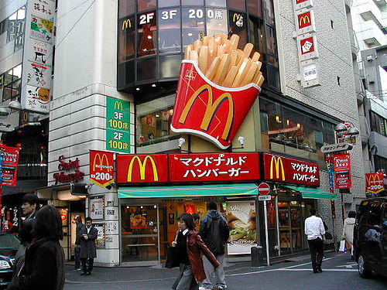
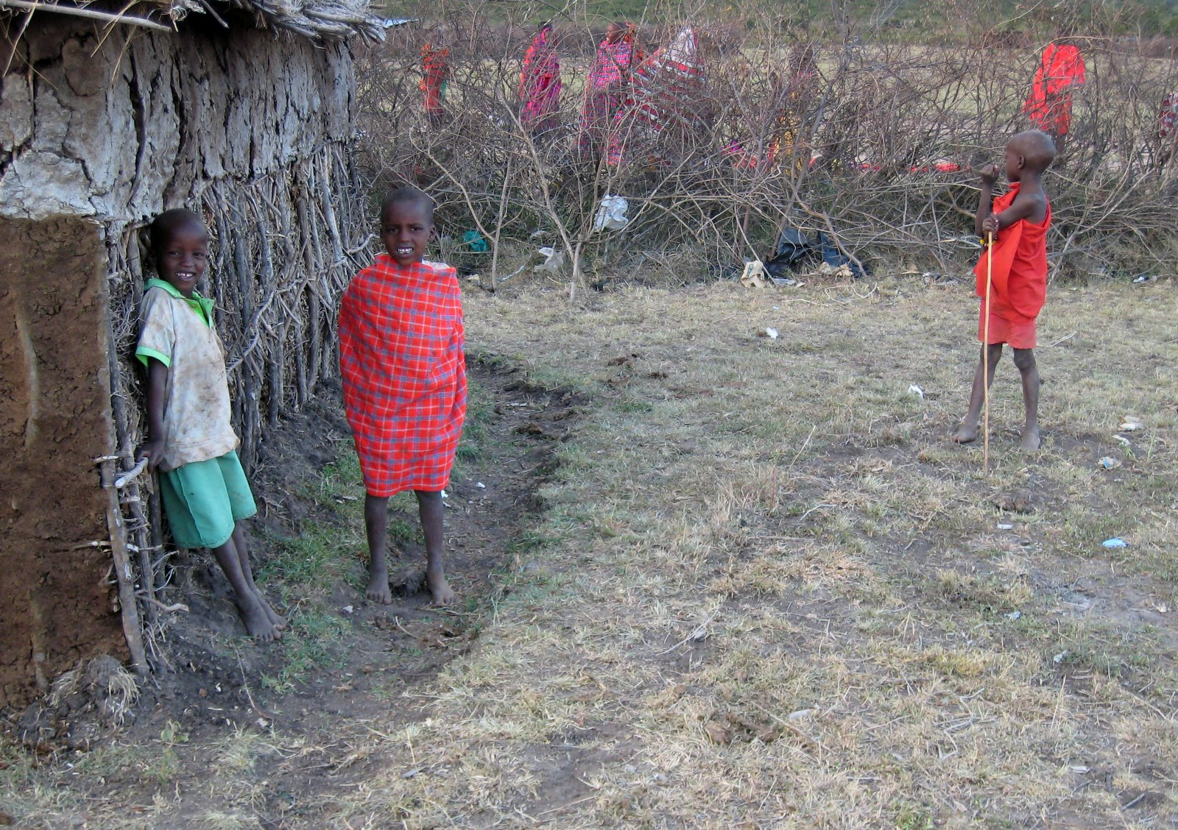
Is this globalization? Why or why not?

Slide 3
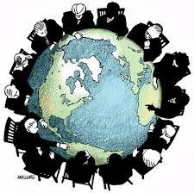
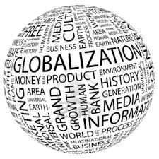
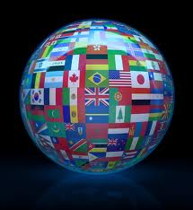
Globalisation is:
The way that companies, ideas and lifestyles are spreading more easily around the world

Slide 4
McDonald’s – A part of globalization
There are approximately 24,500 McDonald’s restaurants in over 115 countries; a new McDonald’s opens somewhere in the world every six hours.
This spreads American ideas and products to many other countries, often faster than other countries.
Some people call this “Americanization”

Slide 5
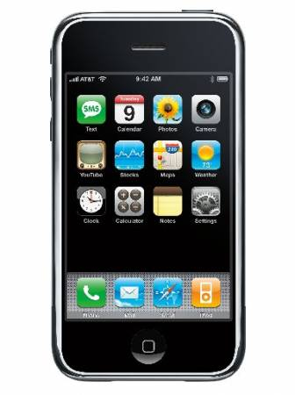
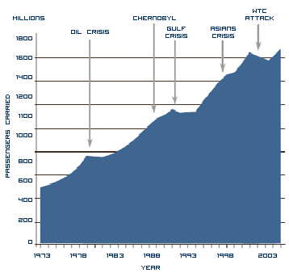
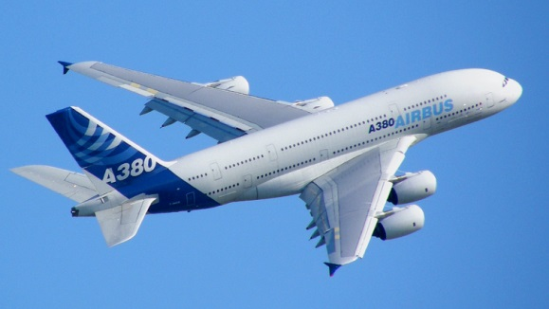
Globalization is fuelled by the ease of transport and communication

Slide 6
How does globalisation affect you?
Task
This person is YOU!
Label the person to show how globalisation affects you. How are you connected to other places?
Here are some ideas:
What food do you like to eat – where does it come from?
What TV and films do you like to watch – where do they come from?
Where were your clothes or other products made?
What types of music do you listen to – where are the artists from?
What sports do you enjoy – where is the sport from?
Do you use the internet? Do you use skype to talk to people in other places?
Do you have a phone?
How often do you fly to other places?
Extension
How can your decisions have an impact on people in other places?

