Slide 1
China and the one child policy….
Positive or negative?

Slide 2
Task:
In ____ China began its famous one child policy for limiting and reducing population. It has now been in effect for ____ years. At first, the program limited couples to having ___ children. Recently this plan has been relaxed to ____ children.
The law has had some unexpected results.
Imagine you are a professor from 1980, before the policy was changed. Your specialty is demography, the study of ________. You are asked to write an article about the possible consequences of this phenomenon. See the worksheet for guidance.
www.stpgeography.weebly.com

Slide 4
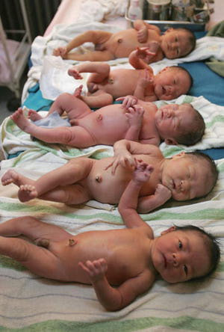
Some key notes:
Twins and triplets were exempt from the one child policy
It was always designed as a ‘temporary measure’
Restricted to ethnic han Chinese living in urban areas
Forced sterilization could accompany breaking the law
If couples got pregnant with a second child, they had to have an abortion
2016 - the policy was revised and all Chinese citizens can now have 2 children

Slide 5
So what happened to china’s population? To the country?

Slide 6
Fertility rate?

Slide 7
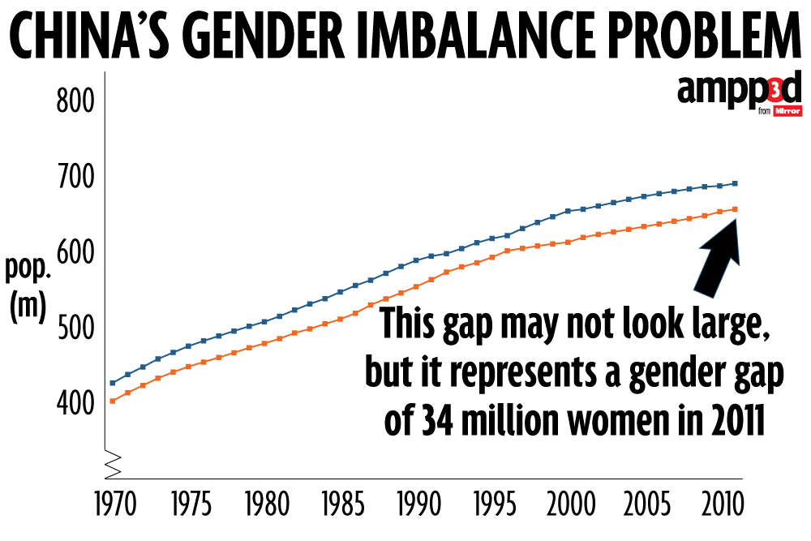
China’s gender gap: there were ____ missing girls

Slide 8
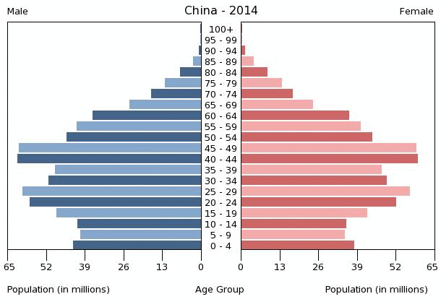
What will happen in 40 years?

